Slide 1
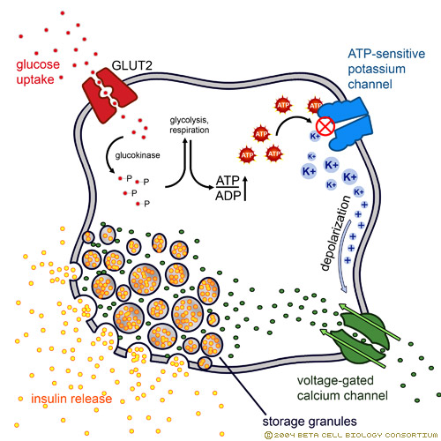
Normal:
K-ATP channel closes when there’s ATP from glucose.
Closed channel makes cell depolarized → release insulin
Hypokalemia = Hyperglycemia
Potassium inside cell tries to compensate by pumping potassium out of the cell.
Channel is not closed → no depolarization →
no insulin release

